Slide 1
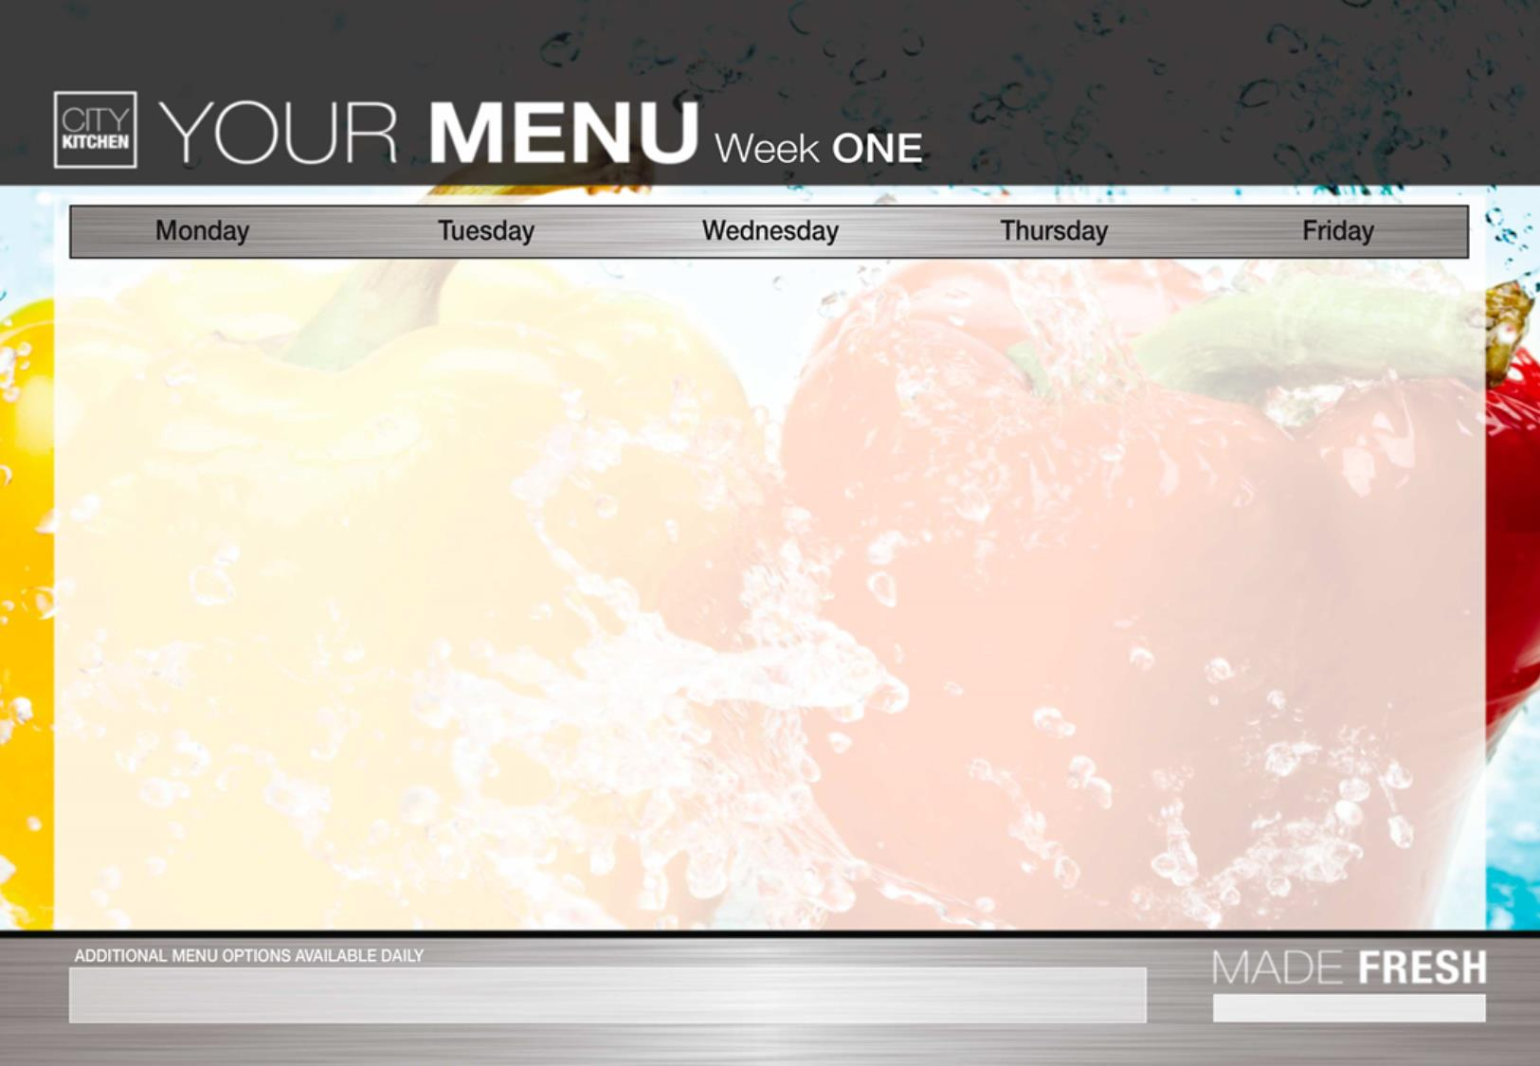
Fish Fingers Marvellous Macaroni Cheese | Meatballs in herby tomato sauce with Spaghetti Jacket Potato served with Cheese or tuna | Roast Chicken Quorn sausage served with mashed potatoes | Jerk Chicken Rice & Peas cheese/onion quiche Potatoes | Homemade Margarita Pizza Vegetable Samosa
Served With Fresh Seasonal Vegetables, potatoes & Salad | Garlic Bread Fresh Seasonal Vegetables | Fresh Seasonal Vegetables, roast potatoes & Salad | Fresh Seasonal Vegetables | Served With Fresh Seasonal Vegetables, chunky chips, baked beans & Salad
Fresh Seasonal Salad Bar With Fresh Bread Available Daily A Daily Selection Of Fresh Fruit & Fruit Yoghurts
Fruit Flap Jack Fresh Fruit Salad Or | Chocolate Square | Fruit Sponge served with custard | Fruit Jelly Fresh Fruit Salad | Assorted Flavoured Ice cream Tubs
Vegetarian options available daily.
For any allergen/dietary requirements please speak to The Catering Supervisor

Slide 2
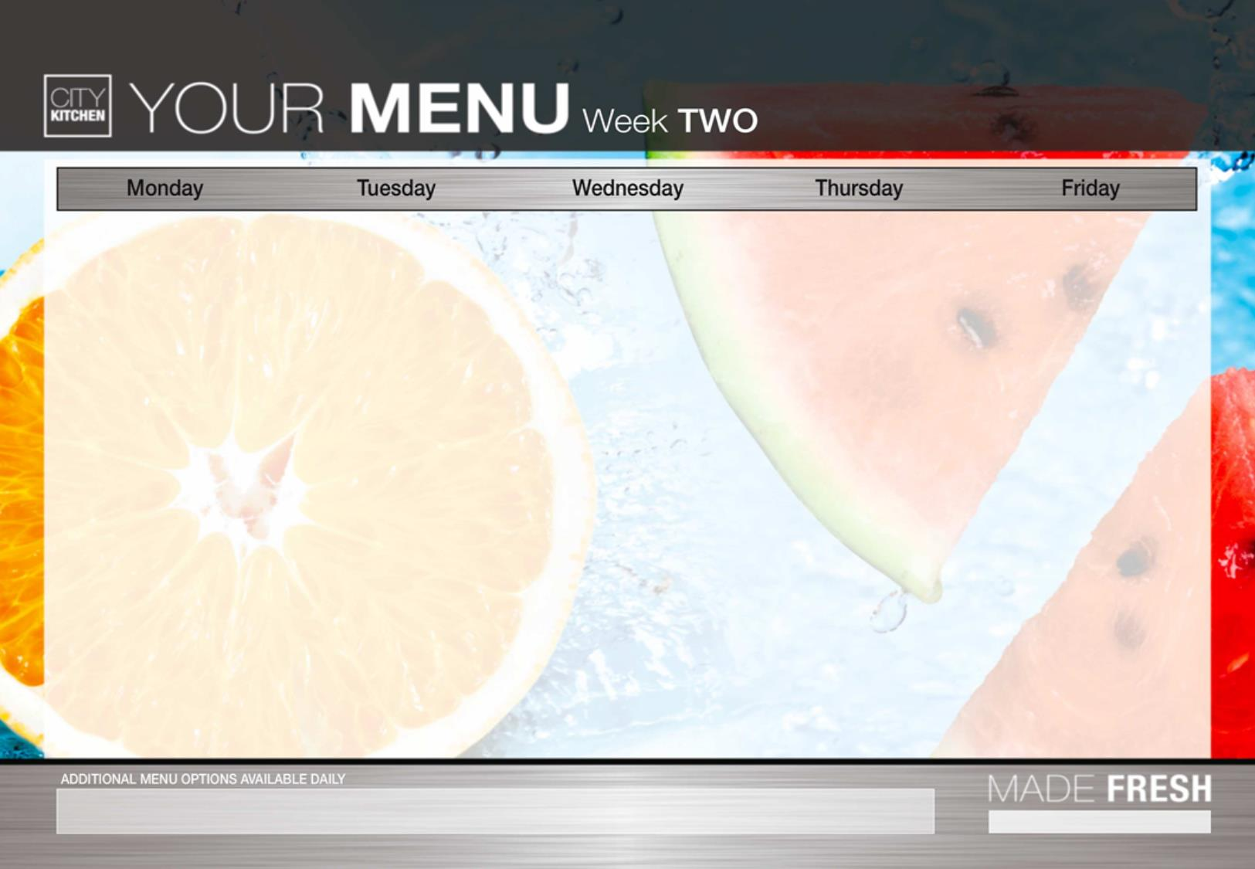
Veggie Burger (V) Cheese or Tuna Jacket Potato |  | Tex – Mex enchiladas with Minced Beef/Quorn Cheese/Onion Pasty | Roasted Chicken Fillet Quorn Roast Both served with gravy | Chicken Tikka Masala With Wholemeal Rice & Naan Quiche & Potatoes | Homemade Margarita Pizza Fish Fingers
Served With seasoned wedges, Fresh Seasonal Vegetables & Salad |  | Herby Diced Potato Seasonal Vegetables & Salad | Served With Fresh Seasonal Vegetables, Roast Potatoes & Salad | Served with Fresh Seasonal Vegetables & Salad | Served With Chunky Chips, Fresh Seasonal Vegetables & Salad
Fresh Seasonal Salad Bar With Fresh Bread Available Daily A Daily Selection Of Fresh Fruit & Fruit Yoghurts
Shortbread Served with Custard | Beetroot & Cocoa Muffins |  | Sultana Cookie | Val’s Orange Sponge & Custard | Assorted Flavoured Ice cream Tubs
Vegetarian options available daily.
For any allergen/dietary requirements please speak to The Catering Supervisor

Slide 3
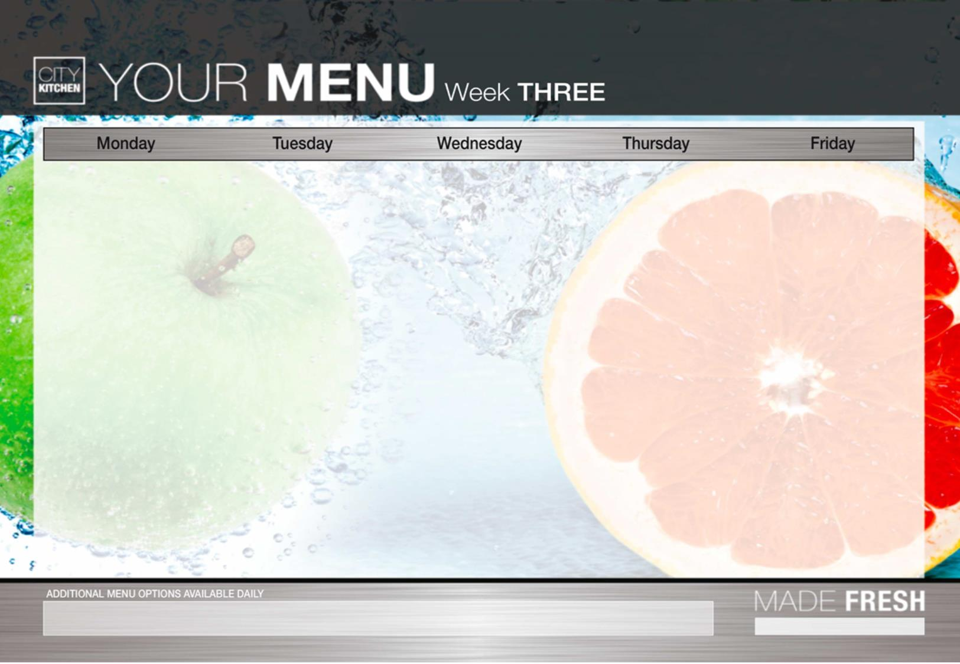
Lamb Bolognaise with Garlic Infused Homemade Bread Cheese and Onion Pasty | Bubble Fish Mediterranean Pasta with Garlic Bread | Traditional Roast Turkey Quorn Roast Served with Stuffing | Sausage Halal Fish Fingers | Homemade Margarita Pizza Shish Kebab
Served with Wholemeal Spaghetti, Fresh Seasonal Vegetables, and salad | Served with Homemade wedges Fresh Seasonal Vegetables | Fresh Seasonal Vegetables With Roast and Mashed Potatoes | Served With Fresh Seasonal Vegetables Mashed Potato & Salad | Served With Fresh Seasonal Vegetables, Chunky Chips & Salad
Fresh Seasonal Salad Bar With Fresh Bread Available Daily A Daily Selection Of Fresh Fruit & Fruit Yoghurts
Fresh Fruit Salad Fruit Jelly | Chocolate Concrete and Custard | Fruit Crumble | Banana Flapjack | Assorted Flavoured Ice cream Tubs
Vegetarian options available daily.
For any allergen/dietary requirements please speak to the Catering Supervisor

